Slide 1
Network
Models
Acadimic Purpose Only (SKK-KIET-CN-IT)

Slide 2
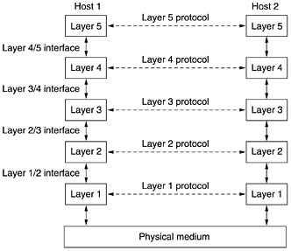
Protocol Hierarchies
Acadimic Purpose Only (SKK-KIET-CN-IT)

Slide 3
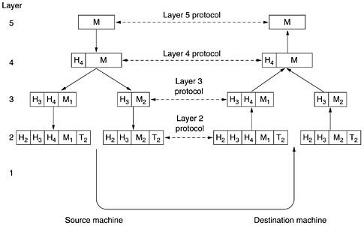
Network Architecture (Virtual Communication between Layers )
Acadimic Purpose Only (SKK-KIET-CN-IT)

Slide 4
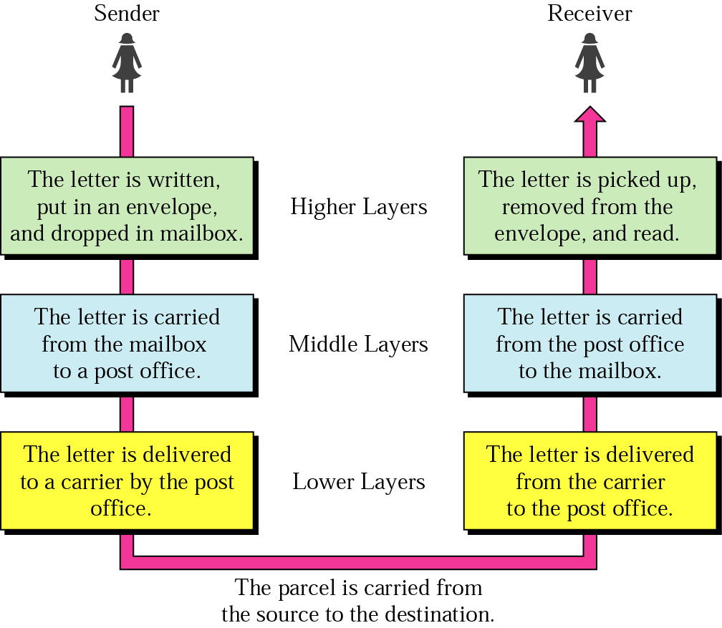
Tasks involved in Sending a letter
Acadimic Purpose Only (SKK-KIET-CN-IT)

Slide 5
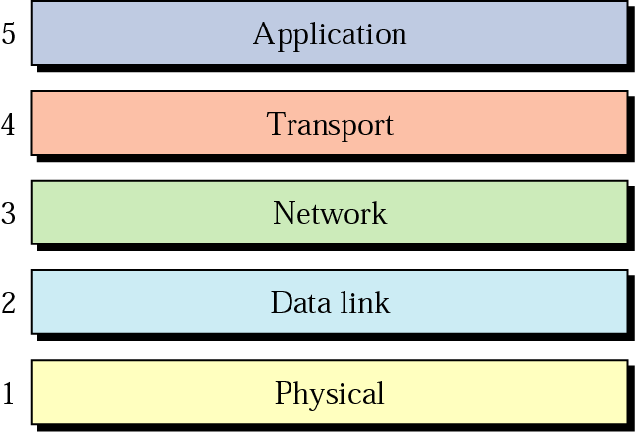
Internet layers
Acadimic Purpose Only (SKK-KIET-CN-IT)

Slide 6
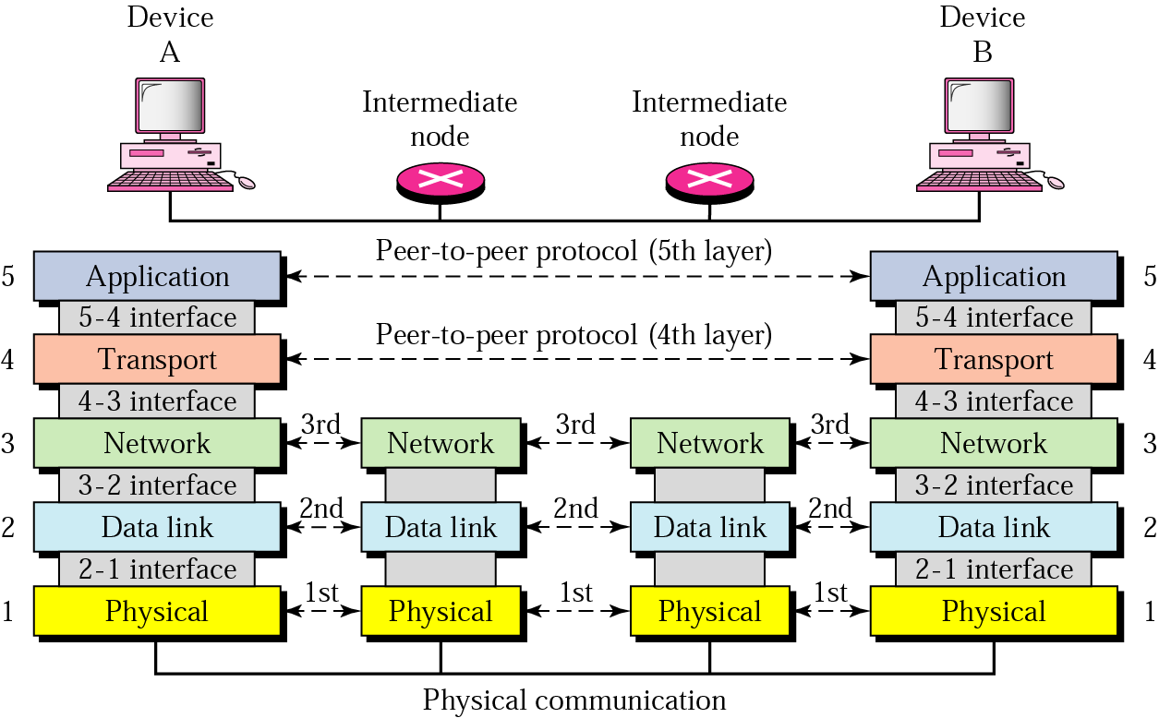
Peer-to-peer processes
Acadimic Purpose Only (SKK-KIET-CN-IT)

Slide 7
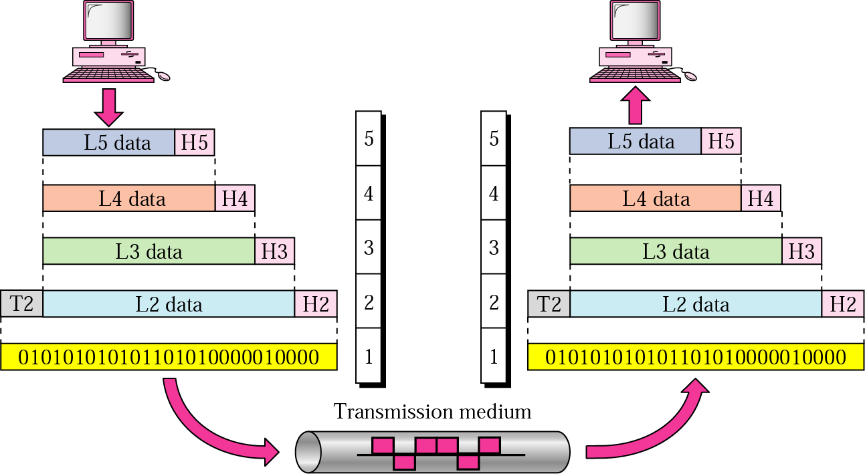
An exchange using the Internet model
Acadimic Purpose Only (SKK-KIET-CN-IT)

Slide 8
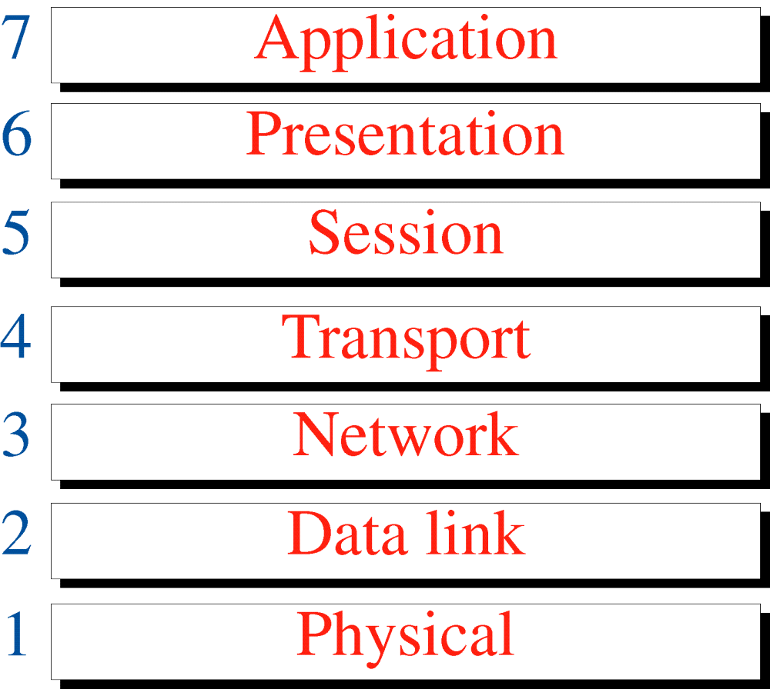
OSI Model
Acadimic Purpose Only (SKK-KIET-CN-IT)

Slide 9
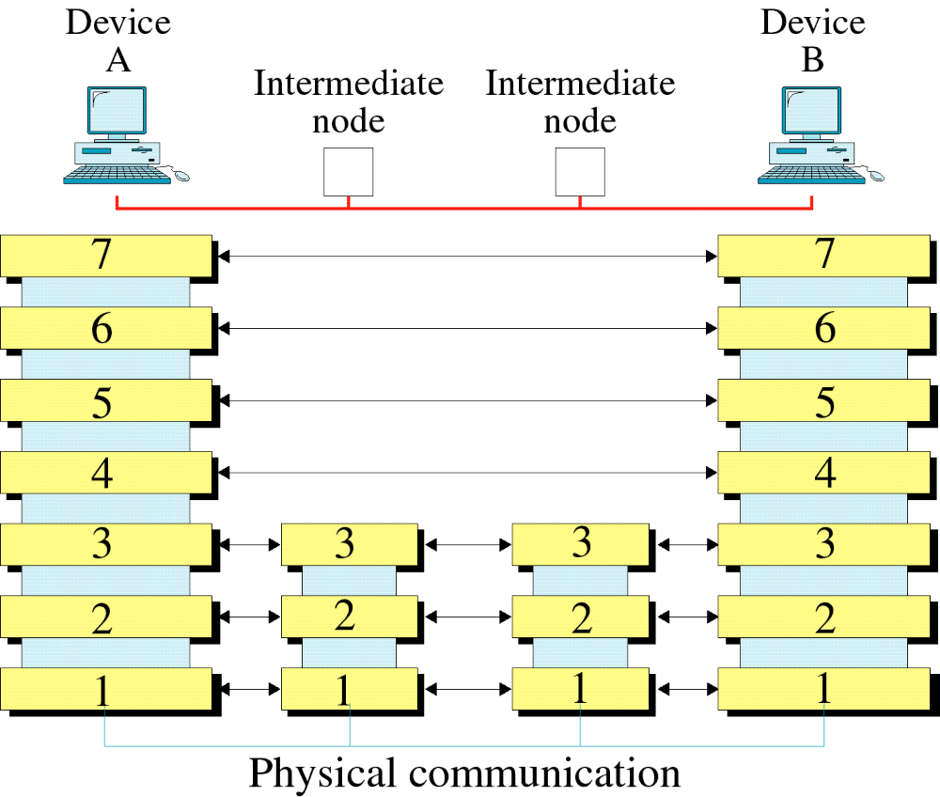
OSI Layers
Acadimic Purpose Only (SKK-KIET-CN-IT)

Slide 10
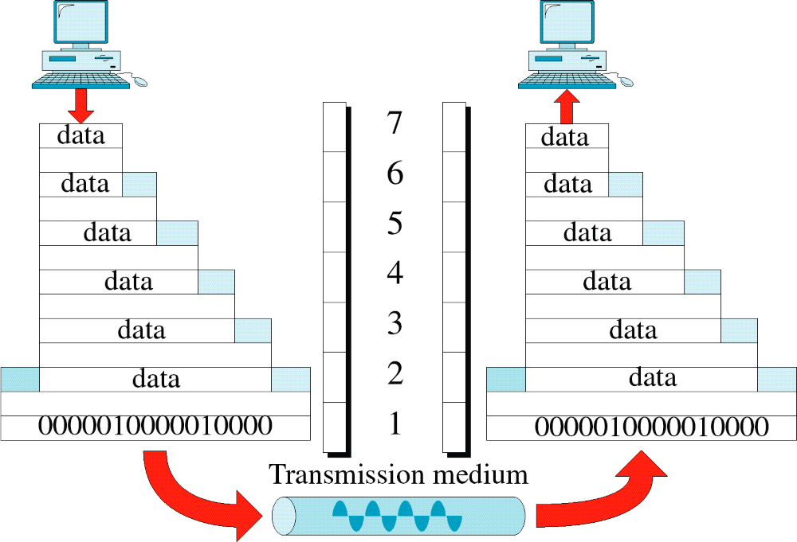
An Exchange Using the OSI Model
Acadimic Purpose Only (SKK-KIET-CN-IT)

Slide 11
Functions of Layers
Acadimic Purpose Only (SKK-KIET-CN-IT)

Slide 12
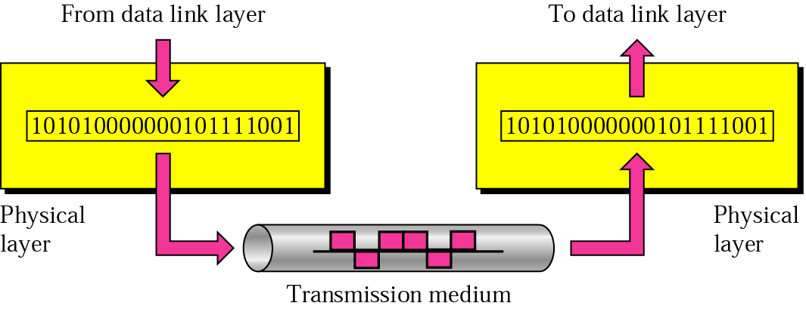
Physical layer
Acadimic Purpose Only (SKK-KIET-CN-IT)

Slide 13

Note:
The physical layer is responsible for transmitting individual bits from one node to the next.
Acadimic Purpose Only (SKK-KIET-CN-IT)

Slide 14
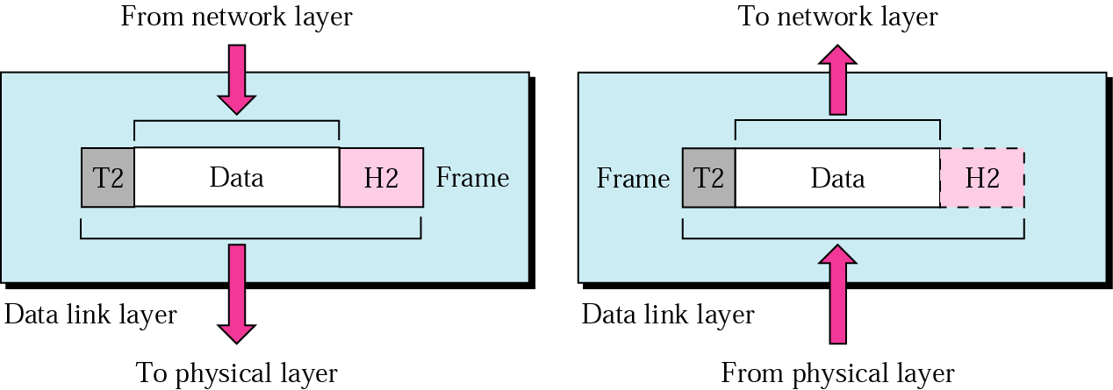
Data link layer
Acadimic Purpose Only (SKK-KIET-CN-IT)

Slide 15
Note:
The data link layer is responsible for transmitting frames from
one node to the next.
Acadimic Purpose Only (SKK-KIET-CN-IT)

Slide 16
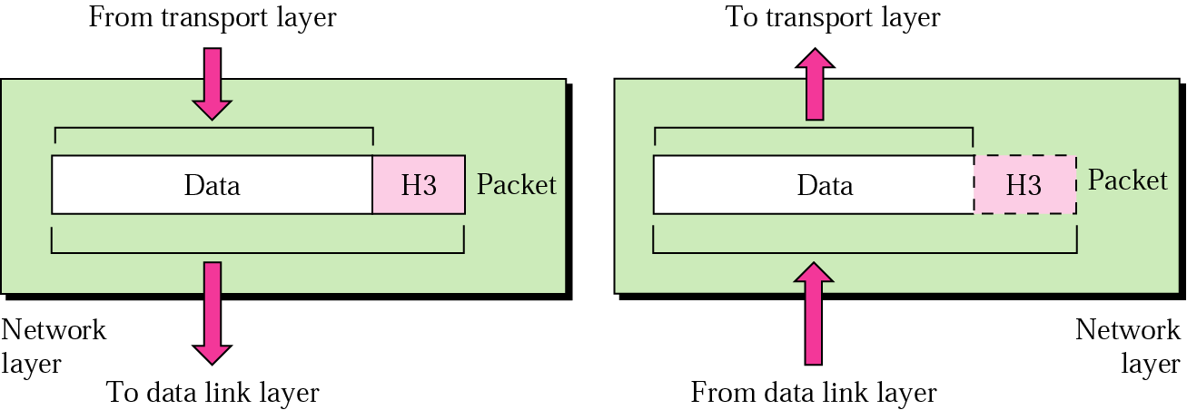
Network layer
Acadimic Purpose Only (SKK-KIET-CN-IT)

Slide 17
Note:
The network layer is responsible for the delivery of packets from the original source to the
final destination.
Acadimic Purpose Only (SKK-KIET-CN-IT)

Slide 18
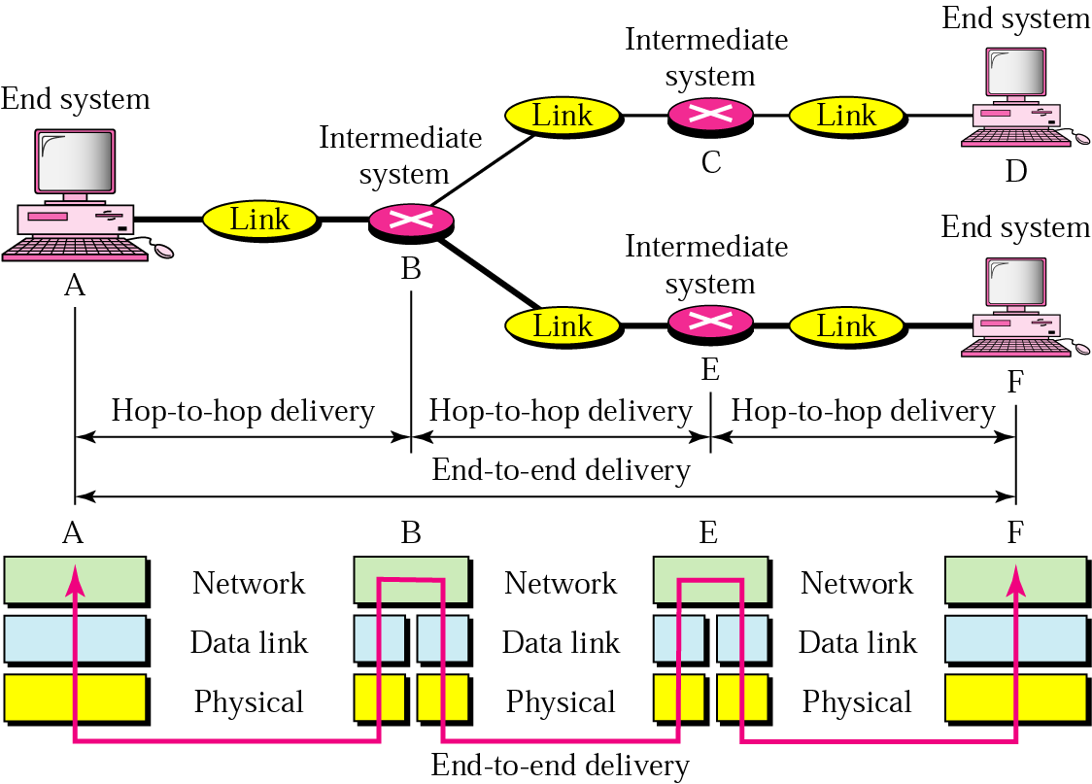
Source-to-destination delivery
Acadimic Purpose Only (SKK-KIET-CN-IT)

Slide 19
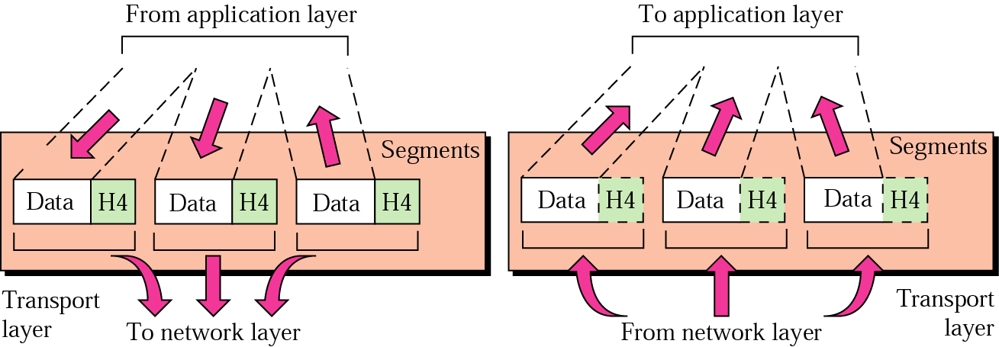
Transport layer
Acadimic Purpose Only (SKK-KIET-CN-IT)

Slide 20
Note:
The transport layer is responsible for delivery of a message from one process to another.
Acadimic Purpose Only (SKK-KIET-CN-IT)

Slide 21
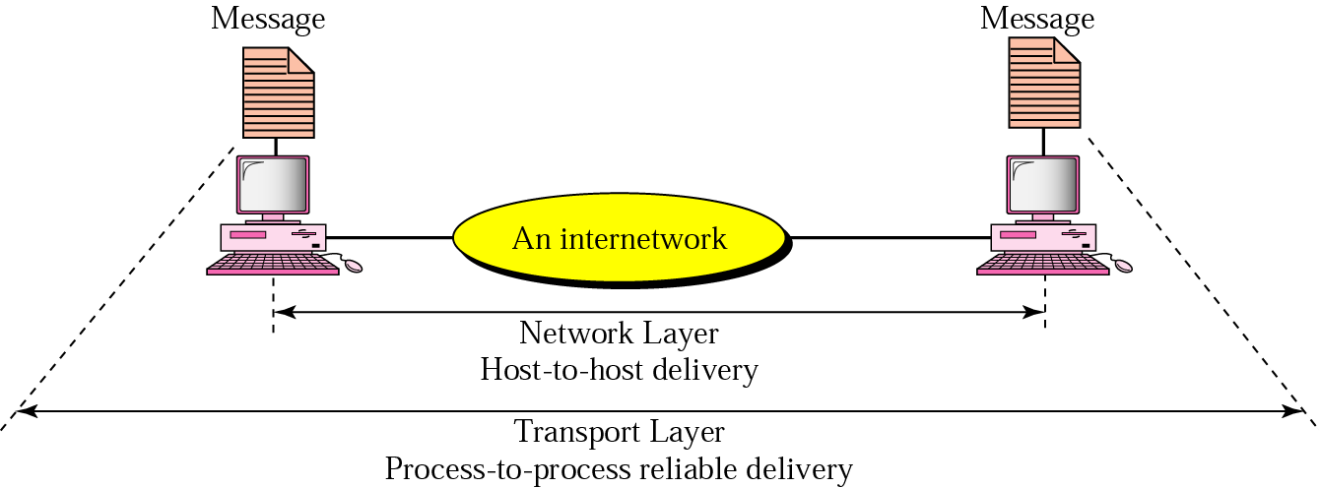
Reliable process-to-process delivery of a message
Acadimic Purpose Only (SKK-KIET-CN-IT)

Slide 22
Example
Data coming from the upper layers have port addresses j and k (j is the address of the sending process, and k is the address of the receiving process). Since the data size is larger than the network layer can handle, the data are split into two packets, each packet retaining the port addresses (j and k). Then in the network layer, network addresses (A and P) are added to each packet.
Acadimic Purpose Only (SKK-KIET-CN-IT)

Slide 23
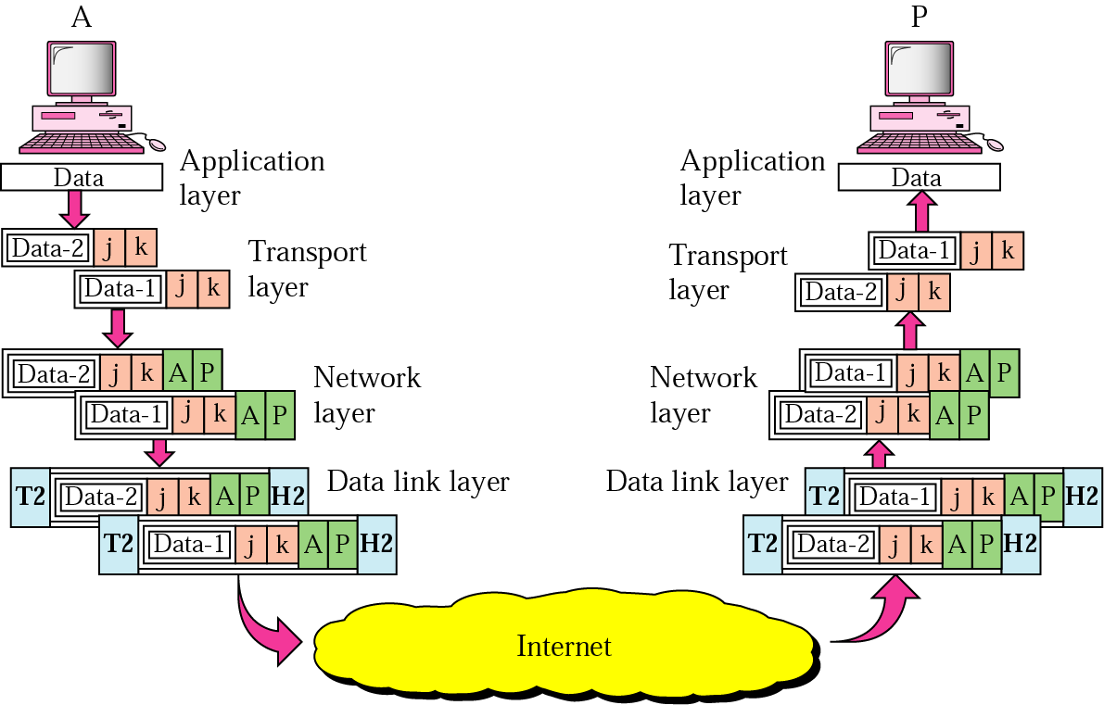
Example
Acadimic Purpose Only (SKK-KIET-CN-IT)

Slide 24
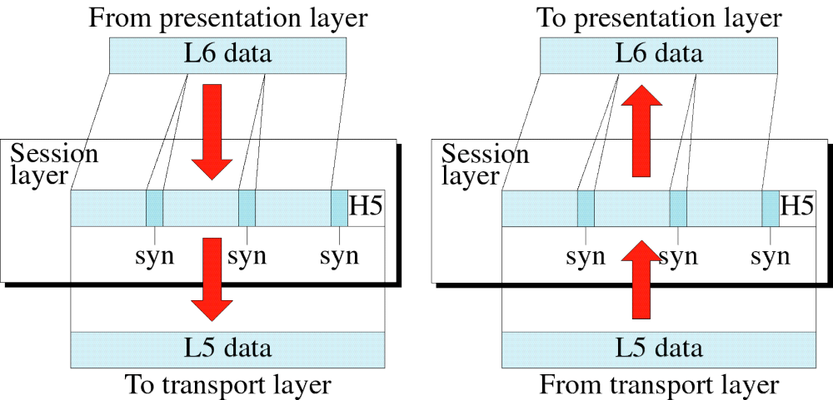
Session Layer
Acadimic Purpose Only (SKK-KIET-CN-IT)

Slide 25
The Session Layer is responsible for dialog control and synchronization.
Acadimic Purpose Only (SKK-KIET-CN-IT)

Slide 26
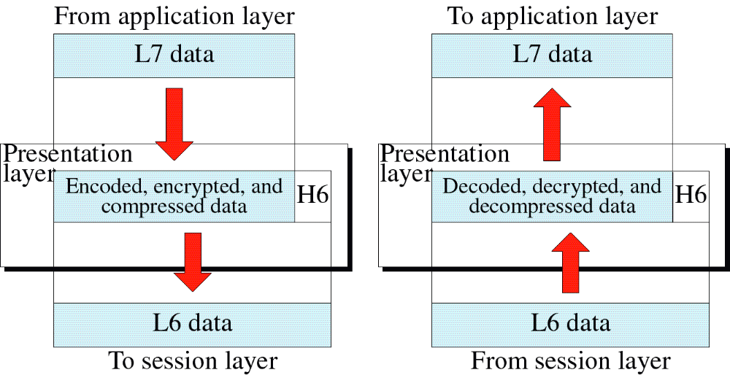
Presentation Layer
Acadimic Purpose Only (SKK-KIET-CN-IT)

Slide 27
The Presentation layer is responsible for translation, compression, and encryption. .
Acadimic Purpose Only (SKK-KIET-CN-IT)

Slide 28
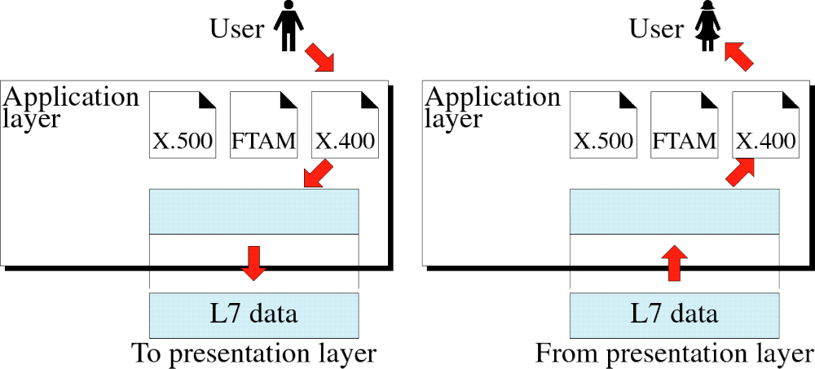
Figure 3-13
Application Layer
Acadimic Purpose Only (SKK-KIET-CN-IT)

Slide 29
Note:
The application layer is responsible for providing services to the user.
Acadimic Purpose Only (SKK-KIET-CN-IT)

Slide 30
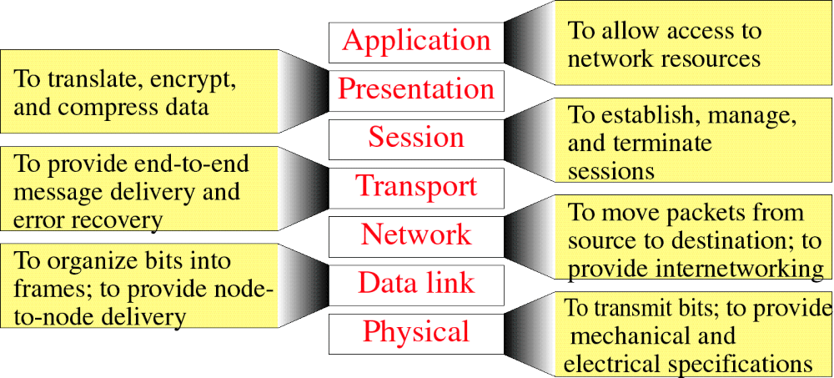
Summary of Layer Functions
Acadimic Purpose Only (SKK-KIET-CN-IT)

Slide 31
A comparison
Acadimic Purpose Only (SKK-KIET-CN-IT)

